Slide 1
User Manual
Axis System

Slide 2
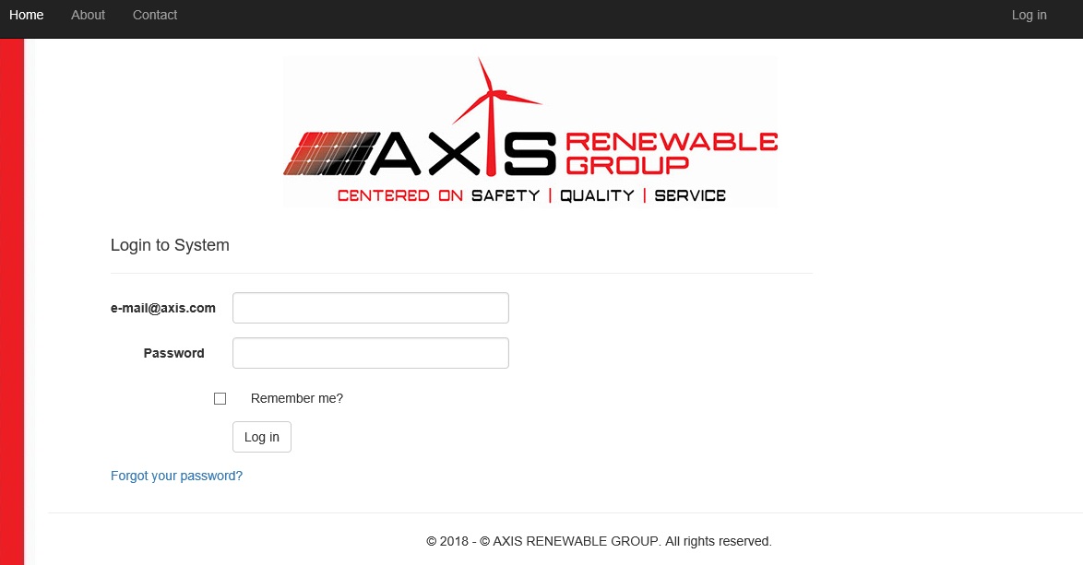
Access and change your passwork
Go to http://www.appsaxisrg.com/

Slide 3
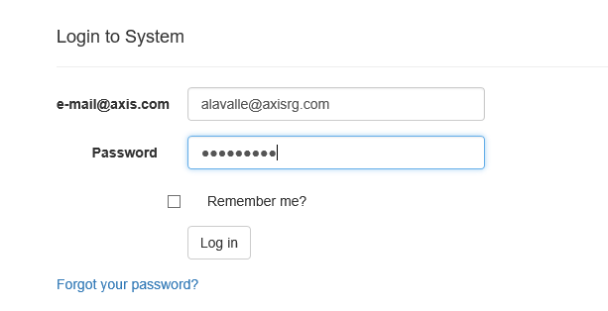
Type your user: example@axisrg.com
Defaul password: Prueba.2017
Click on “Log in” botton

Slide 4
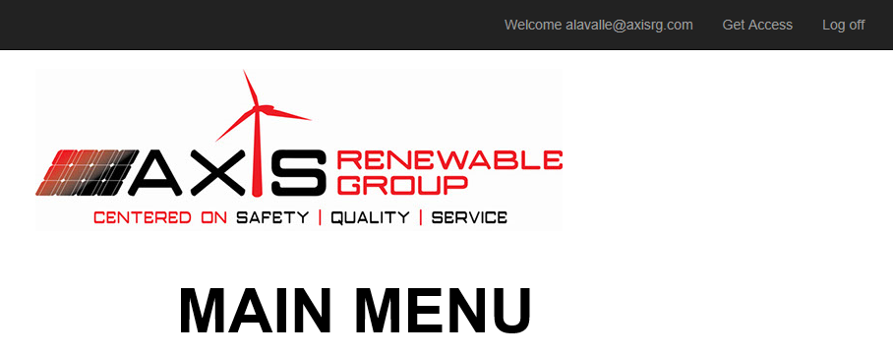
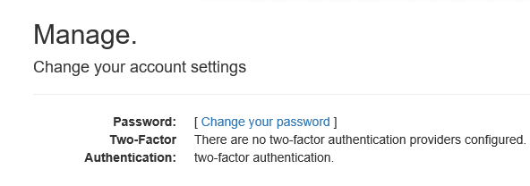
For change your password go to the top right and click on your user name

Slide 5
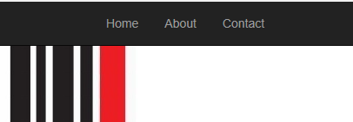

Go Main Menu

Slide 6
Module 1
Business Development

Slide 7

Go to Business Development buttom

Slide 8
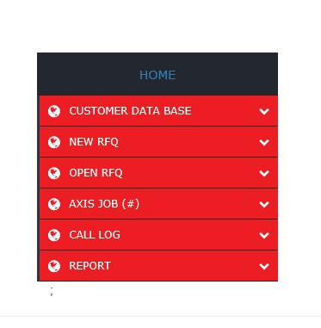
Business Development Menu

